Slide 1
HNDIT11062 – Web Development
Week 4 & 5: Types of websites

Slide 2
Course Content
        Static and Dynamic websites
        Web Syndication and Collaborative websites
        Web 1.0 and Web 2.0

Slide 3
Website
A website is a collection of related web pages containing images, videos or other digital assets.
A web page is a document, typically written in plain text with formatting instructions of Hypertext Markup Language (HTML, XHTML).
Other languages are;
        Java script
        XML
        VB script

Slide 4
Static and Dynamic web sites

Slide 5
Static web Sites
For a static-content Web site, all content appearing on Web pages is placed manually by professional Web developers.
This is also called "design-time page construction," because the pages are fully built while the site is being developed.
Static-content Web site is developed and then maintained by experienced professionals.
Such Web site usually costs less when initially developed, but then all future changes still have to be done by Web professionals.
Therefore, a static Web site can be more expensive to maintain, especially when you want to make frequent changes to your site.

Slide 6
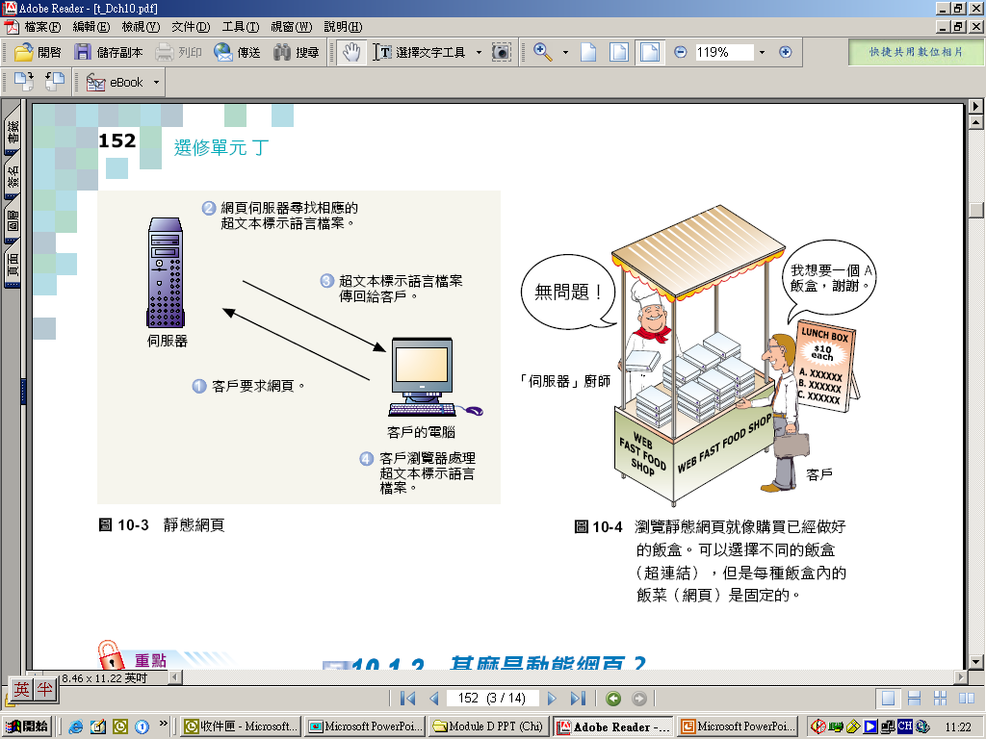
Static web Sites…(cont.)
Static web page
  a web page with contents that remain fixed and unchanged once it has been created by the author
2. Web server looks for the corresponding HTML files
3. HTML files return to client
4. Client browser formats HTML files
1. Client requests
web pages
Client computer
Web server

Slide 7

Static web Sites…(cont.)
Static pages architecture:
Server
Browser sends request
Browser
Server returns document (s)

Slide 8
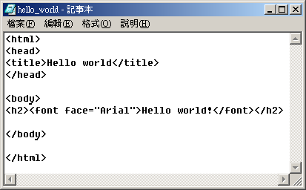
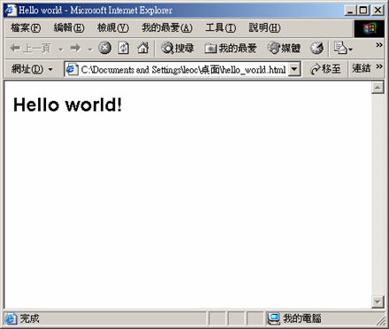
Static web Sites…(cont.)
Static web page

Slide 9
Static web Sites…(cont.)
Static web sites are mainly focused on showing permanent information , where the navigator is limited by itself to obtain the data.
Static web sites can not interact with this information, without interacting with the visited web page.
These kind of web are not able to support web applications as intelligent data base managers, forums, consultations on line, intelligent e-mails...

Slide 10
Advantages
Static web Sites…(cont.)
Quick to develop
Cheap to develop and host
Quick and easy to put together even by someone who doesn’t have much experience
A static web site can be created without any special type of programming ( php , asp ) .
Disadvantages
The only disadvantage of the static websites resides on the hard updating as well as the loss of powerful tools supported with data bases, like the creation of historical registers of the clients, orders online ..

Slide 11
Dynamic web Sites
Dynamic websites contain Web pages that are generated in real-time.
  A web page with contents generated “on-the-fly” by the server or the client computer according to clients’ requests
These pages include Web scripting code, such as PHP or ASP.
When a dynamic page is accessed, the code within the page is parsed on the Web server and the resulting HTML is sent to the client's Web browser.
  e.g. return the system’s current date and time to the server browser (written in Active Server Page)

Slide 12
Dynamic web Sites… (cont.)
Dynamic-content Web site, while still developed by professionals, can be maintained directly by you, our customer.
Such Web site initially costs more to develop, but then you don't have to pay Web professionals every time you need to change something on your site.
If you plan to make frequent changes to your site, you most likely will be better off with a dynamic Web site.

Slide 13
Dynamic web Sites… (cont.)
Examples of dynamic website features could be:
content management system
e-commerce system
bulletin / discussion boards
intranet or extranet facilities
ability for clients or users to upload documents
ability for administrators or users to create content or add information to a site (dynamic publishing).

Slide 14
Advantages
Dynamic web Sites… (cont.)
Much more functional website
Much easier to update
New content brings people back to the site and helps in the search engines
Can work as a system to allow staff or users to collaborate
Disadvantages
Slower / more expensive to develop
Hosting costs a little more

Slide 15
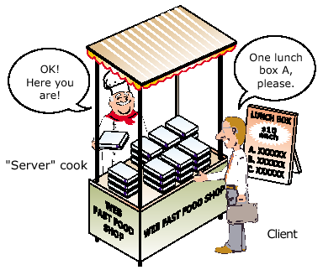
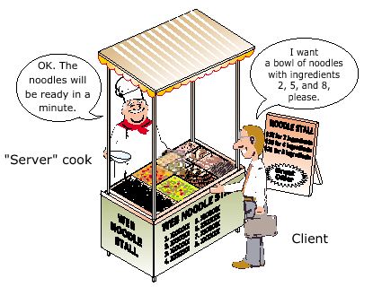
E.g. Static vs. dynamic web pages
Buying ready-made lunch boxes:
browsing static web pages
Ordering noodles in a noodle stall:
browsing dynamic web pages

Slide 16
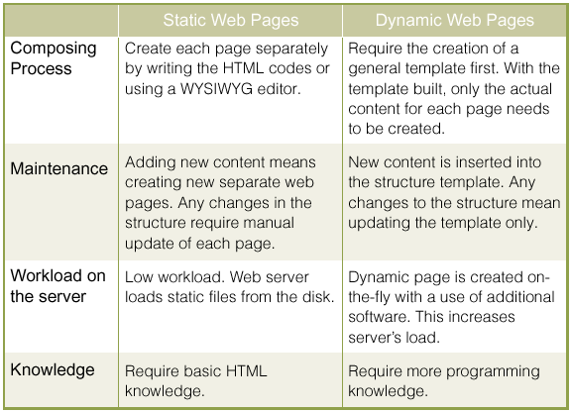
Comparison between static and dynamic web pages

Slide 17
Classification of dynamic web pages
  Client-side dynamic web pages
    The creation of the web pages takes place in the client computer
  2. Server-side dynamic web pages
    The server is responsible for creating the web pages

Slide 18
Client-Side Dynamic Web Pages Vs
Server-Side Dynamic Web Pages
client-side dynamic web pages
4. Client browser processes instructions and HTML codes
Client-side
Server-side
1. Client requests the web pages
3. HTML codes and instructions return to client
Client computer
Web server
5. Browser displays web pages
2. Web server looks for HTML files together with instruction files

Slide 19
Client-Side Dynamic Web Pages Vs
Server-Side Dynamic Web Pages
server-side dynamic web pages
Client-side
Server-side
2. Web server looks for instruction files
1. Client requests the web pages
3.Web server processes instructions and creates the necessary HTML codes
4. HTML codes return to client
Client computer
5. Client browsers display the web pages
Web server

Slide 20
Dynamic pages architecture:
Browser
Browser requests document
e.g form on web page
Server sends complete document
Server
Server rec. CGI request
Perl Program
Program constructs new document or sends specific one that already exists
Notes:
CGI - Common Gateway Interface

Slide 21
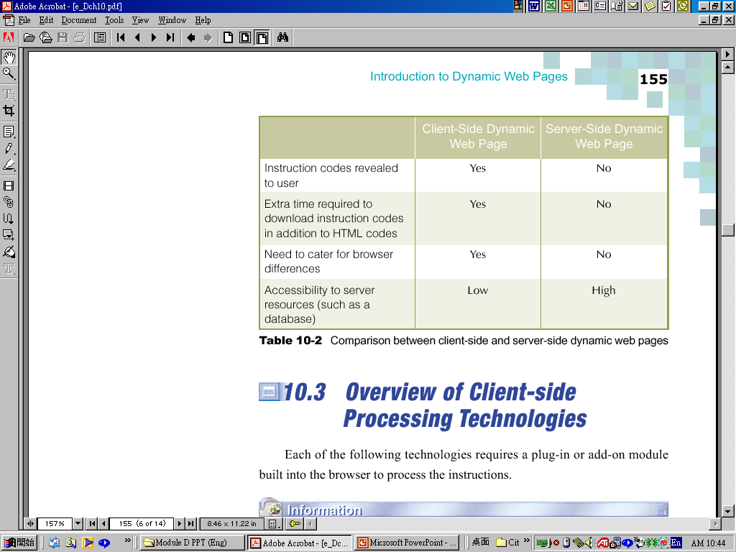
Client-Side Dynamic Web Pages Vs
Server-Side Dynamic Web Pages
Comparison between client-side and server-side
dynamic web pages

Slide 22
Client-Side Processing Technologies
JavaScript
VBScript
Java
Java Applets
Common Gateway Interface (CGI)
Active Server Pages (ASP)
HyperText Preprocessor (PHP)

Slide 23
Collaborative and Syndication
Web sites

Slide 24
Web syndication
A marketing strategy for websites.
A form of syndication in which website material is made available to multiple other sites.
Refers to making web feeds available from a site in order to provide other people with a summary or update of the website's recently added content
E.g. The latest news or forum posts
Web syndication describes an arrangement between two or more Internet companies for one company to provide material to be made available on the other party's site.
Syndication benefits both the websites providing information and the websites displaying it.

Slide 25
Collaborative Web sites
A collaborative Web site comprises the perpetual collective work of many authors.
E.g.
Similar to a blog in structure and logic
A wiki allows anyone to edit, delete or modify content that has been placed on the Web site using a browser interface, including the work of previous authors.
A blog, typically authored by an individual, does not allow visitors to change the original posted material, only add comments to the original content.

Slide 26
Collaborative Web sites…
Allows individuals to create or upload documents to the web where they can be.
Users can share their thoughts, projects, links, etc. with others.
Users can respond to others ideas.
Access can be restricted to selected users.
Password protection is available.

Slide 27
Wiki
A website that allows the easy creation and editing of any number of interlinked Web pages, using a simplified markup language or a WYSIWYG text editor, within the browser.
Typically powered by wiki software.
Often used to create collaborative web sites, in knowledge management systems etc.
Blog
A websites where entries are written in chronological order and commonly displayed in reversed chronological order.
Provide commentary or news on a particular subject.
A typical blog combines text, images, links to other blogs, web pages, and other media related to its topic.
The ability for readers to leave comments in an interactive format.

Slide 28
Collaboration and Social Computing
Users create and control collaborative workspaces using standard meeting and team site templates.
Coordinate teamwork with shared calendars, alerts, and notifications.
Capture best practices and expertise using blogs, wikis, Really Simple Syndication (RSS) and surveys.

Slide 29
What is Social Networking?
Social networking is the grouping of individuals into specific groups, like small rural communities or a neighborhood subdivision, if you will.
Although social networking is possible in person, especially in the workplace, universities, and high schools, it is most popular online.

Slide 30
E.g.
Name | Description
Academia.edu | Social networking site for academics/researchers
My space | leading social entertainment destination powered by the passion of fans. Music, movies, celebs, TV, and games made social.
Facebook | Social networking for every one
Advogato | Free and open source software developers
Youtube, Twitter, etc.

Slide 31
Social Networking… (cont.)
Advantages
The most cost effective way to keep in touch with your people (friends, classmates, and relatives etc.).
Not bound by any geographical and cultural differences. These sites are a window to different cultures and places.
Allows to send and receive messages, upload photos, and videos.
A tool to promote business, services, products, or websites. Etc.
Disadvantages
The risk of identity theft and fraud.
The personal information of users can be used by dubious people for illegal activities. Information like the e-mail address, name, location, and age can be used to commit online crimes.
If you do not know the person face to face then it will be very hard for you to find the real identity.
Online harassment and stalking

Slide 32
Web 1.0 Vs. Web 2.0

Slide 33
Web 1.0
Sir Tim Berners‐Lee
Uniform access to disparate sources of information, without differences between data sources
Web 1.0, or web, refers to the first stage of the World Wide Web linking WebPages with hyperlinks.
Hyperlinks between WebPages began with the release of the WWW to the public in 1993

Slide 34
Web 1.0 … (cont.)
Some design elements of a Web 1.0 site include:
Static pages instead of dynamic user-generated content.
The use of framesets
The use of tables to position and align elements on a page.
These were often used in combination with "spacer" GIFs (1x1 pixel transparent images in the GIF format.
HTML forms sent via email.

Slide 35
Web 2.0
The term Web 2.0 is associated with web applications that facilitate participatory information sharing, interoperability, user-centered design and collaboration on the World Wide Web.
A Web 2.0 site allows users to interact and collaborate with each other in a social media dialogue as creators of user-generated content in a virtual community.

Slide 36
Web 2.0 … (cont.)
E.g.
social networking sites
facebook, Twitter, Flicker, MySpace etc.
Blogs
Wikis
MSN
video sharing sites
YouTube etc.
hosted services

Slide 37
Web 2.0 … (cont.)
Emerging Technology
Web Services / API’s
“Folksonomies” / Content tagging
“AJAX”
RSS
Applications You
Know…
Flicker
Google Maps
Blogging & Content Syndication
Amazon API’s
Google Adsense API
Yahoo API
Ebay API
Major Retailers

Slide 38
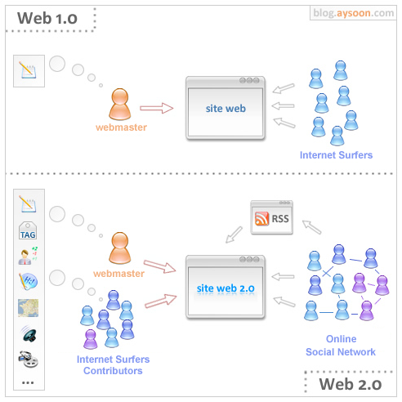
Notes:
RSS - Really Simple Syndication

Slide 39
Web 2.0: Evolution Towards a Read/Write Platform
Web 1.0 (1993-2003) Pretty much HTML pages viewed through a browser |  | Web 2.0 (2003- beyond) Web pages, plus a lot of other “content” shared over the web, with more interactivity; more like an application than a “page”
“Read” | Mode | “Write” & Contribute
“Page” | Primary Unit of content | “Post / record”
“static” | State | “dynamic”
Web browser | Viewed through… | Browsers, RSS Readers, anything
“Client Server” | Architecture | “Web Services”
Web Coders | Content Created by… | Everyone

Slide 40
WEB 1.0 Vs. Web 2.0
WEB 1.0 | WEB 2.0
“the mostly read only web” | “the wildly read-write web”
focused on companies e.g. Dot com, Bubble | focused on communities e.g. MySpace, Facebook
home pages | blogs
owning content | sharing content
HTML, portals | XML, RSS
web forms | web applications
directories (taxonomy) | tagging ("folksonomy")
about wires | about wireless.
Netscape | Google
dial up | broadband
Yahoo mail 1998 with 2 MB of storage. | Google Mail (Gmail) with 2GB of storage.

Slide 41
lesson review
Differentiate Static and Dynamic web sites.
Differentiate collaborative and Syndication web sites.
Differentiate Web 1.0 Vs. Web 2.0.
Describe how to migrate contents from Web 1.0 to Web 2.0.
Identify web sites under following categories
        Static and Dynamic
        Collaborative and Syndication
        Web 1.0 and Web 2.0

